Slide 1

Understanding Dynamics CRM
Web Services

Slide 2

Mitch Milam
Dynamics CRM Architect
  Independent consultant and trainer
  Ten-Time Dynamics CRM MVP
  mitch@xrmcoaches.com
  infinite–x.net
  @mitchmilam
  http://tinyurl.com/MitchMilamLinkedIn

Slide 3
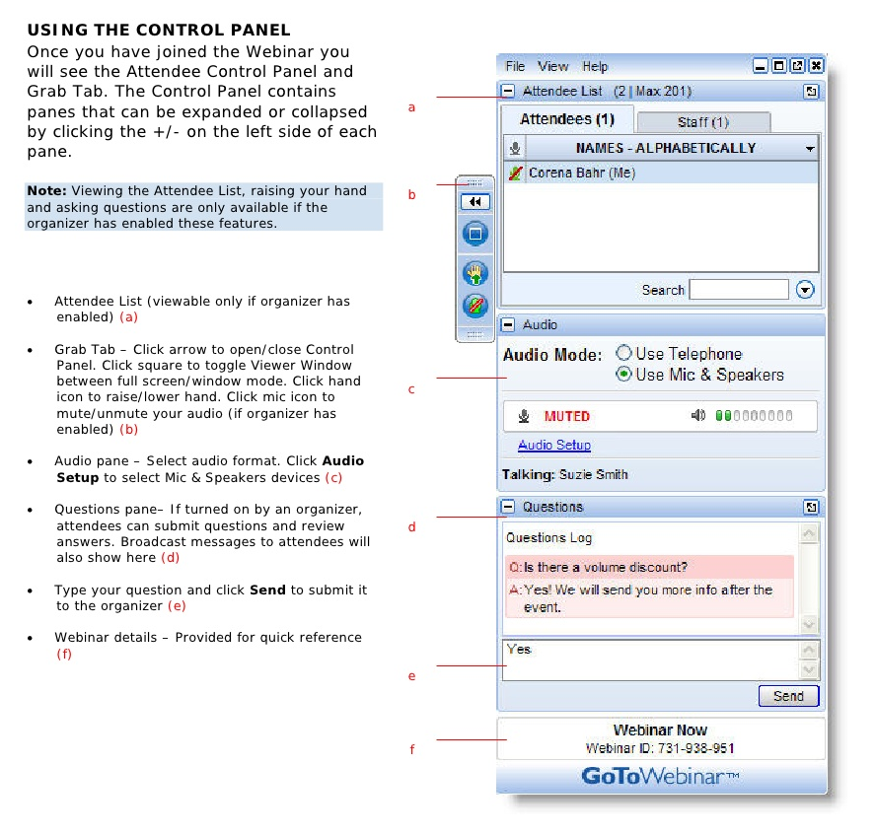
Webinar Housekeeping

Slide 4



2016 Training Roadmap
Webinars
http://www.xrmcoaches.com/webinars
KnowledgeBits
http://www.xrmcoaches.com/knowledgebits
Learning Plans
  http://www.xrmcoaches.com/freestuff
More Goodies
  Practice tests
  On–Demand
  video training
  Instructor–led
  training
  Books

Slide 5
Agenda
Overview
WebAPI Primer
Existing Service Code and Libraries
Code and Tool Review
Non-JavaScript-Related Discussions

Slide 6
Overview

Slide 7
THE Announcement
As of the release of Microsoft Dynamics CRM Online 2016 Update 1 and Microsoft Dynamics CRM 2016 Service Pack 1 (8.1.0), the CRM 2011 endpoint has been deprecated. The 2011 endpoint will be removed sometime after CRM version 9.
https://msdn.microsoft.com/en-us/library/dn281891.aspx#Crm2011Endpoint

Slide 8
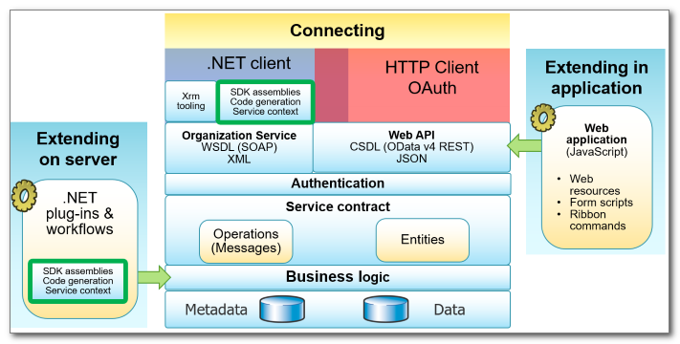
Dynamics CRM 2016 Programming Model

Slide 9
WebAPI Primer

Slide 10
Features and Functionality
Implements the OData (Open Data Protocol), version 4.0
Build HTTP-based services, both inside and outside of the Dynamics CRM
You interact with the Web API by composing and sending HTTP requests.
You need to know how to set the appropriate HTTP headers and handle any errors included in the response.
HTTP methods used include GET, POST, PATCH, DELETE and PUT
Use to build a wide variety of client applications (browser, mobile, desktop) and with a variety of different programming languages (JavaScript, C#, Node.js, Python, etc.)

Slide 11
Features and Functionality
There are no client dependencies on the Dynamics CRM SDK assemblies
Available for CRM Online, on-premises, and Internet-facing deployment (IFD)
Perform CRUD (Create, Read, Update and Delete) operations
Execute CRM Actions (reusable operations in CRM, such as WinOpportunity)
Execute batch requests

Slide 12
Self–Documenting
Return all entity sets
[organization URI]/api/data
Return all metadata
[organization URI]/api/data/$metadata

Slide 13
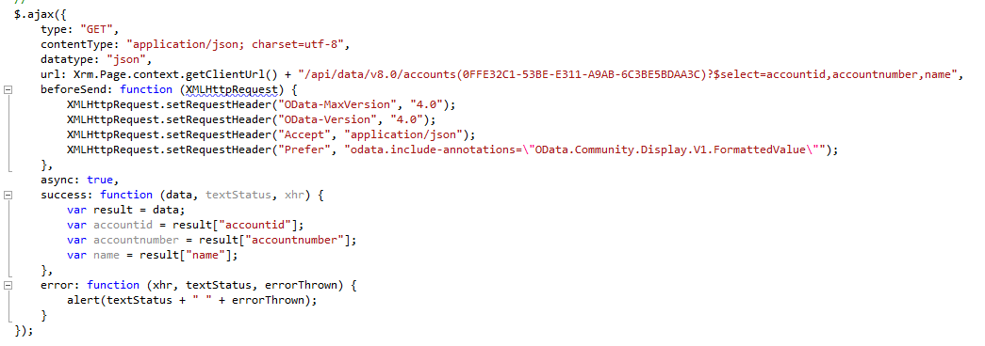
Example (Retrieve)

Slide 14
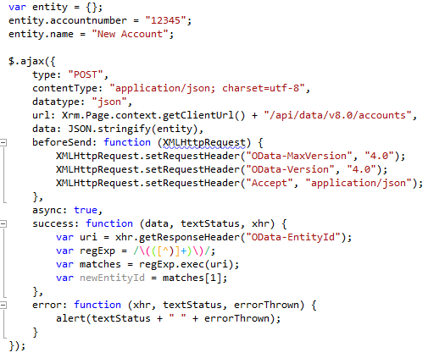
Example (Create)

Slide 15
Primitive types
2011 Endpoint Data type | Web API type
BigInt | Edm.Int64
Boolean | Edm.Boolean
CalendarRules | N/A
Customer | Single-valued navigation properties
DateTime | Edm.DateTimeOffset
Decimal | Edm.Decimal
Double | Edm.Double
EntityName | Edm.String
Image | Edm.Binary
Integer | Edm.Int32
Lookup | Single-valued navigation property
ManagedProperty | N/A
Memo | Edm.String
Money | Edm.Decimal
Owner | Single-valued navigation properties
PartyList | Collection-valued navigation property to the activityparty entity type.
Picklist | Edm.Int32
State | Edm.Int32
Status | Edm.Int32
String | Edm.String
Uniqueidentifier | Edm.Guid

Slide 16
Entity Types
Label | Description
[Description] | A description of the entity type.
Collection URL | The URL to retrieve entities of this type.
Display Name | The Display Name for the entity.
Primary Key | The Primary Key for the entity.

Slide 17
Type Inheritance
All entities inherit from crmbaseentity
Activities inherit from activitypointer
SystemUser and Team inherit from principle

Slide 18
Entity Properties
Property | Description
Name | The name of the property you will use in code.
Display Name | The display name of the property that may be visible in the application.
Type | The type of the property. All properties have primitive types.
Computed | Whether the value of the property is set by the system.
Permission | Only two options are available here: Read or ReadWrite. When a property only has Read permission, you cannot set the value of the property.
Description | A description of the property.

Slide 19
Navigation Properties
Property | Description
Name | The name of the property you will use in code.
Type | The entity type that can be set for the navigation property.
Self-referential Partner | Usually in a 1:N relationship there is a corresponding collection-valued navigation property on the other entity with the same name. However, when the navigation property represents a self-referential relationship there cannot be two navigation properties with the same name. In this case the single-valued navigation property will be prefixed by ‘Referencing’ and the collection-valued navigation property will be prefixed by ‘Referenced’.

Slide 20
Terminology
Bound
Related to a specific entity
Unbound
Not related to any specific entity

Slide 21
Functions
A function is an operation which does not have observable side effects
They typically retrieve data
They may have parameters and they may return values
Functions may be bound to entity types

Slide 22
Function List
CalculateTotalTimeIncident Function
CheckIncomingEmail Function
CheckPromoteEmail Function
DownloadReportDefinition Function
ExpandCalendar Function
ExportFieldTranslation Function
FindParentResourceGroup Function
GetAllTimeZonesWithDisplayName Function
GetDefaultPriceLevel Function
GetDistinctValuesImportFile Function
GetHeaderColumnsImportFile Function
GetQuantityDecimal Function
GetReportHistoryLimit Function
GetTimeZoneCodeByLocalizedName Function
GetValidManyToMany Function
GetValidReferencedEntities Function
GetValidReferencingEntities Function
IncrementKnowledgeArticleViewCount Function
InitializeFrom Function
IsComponentCustomizable Function
IsDataEncryptionActive Function
IsValidStateTransition Function
QueryMultipleSchedules Function
QuerySchedule Function
RetrieveAbsoluteAndSiteCollectionUrl Function
RetrieveAllChildUsersSystemUser Function
RetrieveAllEntities Function
RetrieveApplicationRibbon Function
RetrieveAuditPartitionList Function
RetrieveAvailableLanguages Function
RetrieveBusinessHierarchyBusinessUnit Function
RetrieveByGroupResource Function
RetrieveByResourceResourceGroup Function
RetrieveByTopIncidentProductKbArticle Function
RetrieveByTopIncidentSubjectKbArticle Function
RetrieveCurrentOrganization Function
RetrieveDataEncryptionKey Function
RetrieveDependenciesForDelete Function
RetrieveDependenciesForUninstall Function
RetrieveDependentComponents Function
RetrieveDeploymentLicenseType Function
RetrieveDeprovisionedLanguages Function
RetrieveDuplicates Function
RetrieveEntityRibbon Function
RetrieveExchangeRate Function
RetrieveFormattedImportJobResults Function
RetrieveInstalledLanguagePacks Function
RetrieveInstalledLanguagePackVersion Function
RetrieveLicenseInfo Function
RetrieveLocLabels Function
RetrieveMailboxTrackingFolders Function
RetrieveMembersBulkOperation Function
RetrieveMissingComponents Function
RetrieveMissingDependencies Function
RetrieveOrganizationResources Function
RetrieveParentGroupsResourceGroup Function
RetrieveParsedDataImportFile Function
RetrievePersonalWall Function
RetrievePrincipalAccess Function
RetrievePrincipalAttributePrivileges Function
RetrievePrincipalSyncAttributeMappings Function
RetrievePrivilegeSet Function
RetrieveProductProperties Function
RetrieveProvisionedLanguagePackVersion Function
RetrieveProvisionedLanguages Function
RetrieveRecordWall Function
RetrieveRequiredComponents Function
RetrieveRolePrivilegesRole Function
RetrieveSubGroupsResourceGroup Function
RetrieveTeamPrivileges Function
RetrieveTimestamp Function
RetrieveUnpublishedMultiple Function
RetrieveUserPrivileges Function
RetrieveUserQueues Function
RetrieveVersion Function
Search Function
SearchByBodyKbArticle Function
SearchByKeywordsKbArticle Function
SearchByTitleKbArticle Function
ValidateRecurrenceRule Function
WhoAmI Function
CalculateRollupField Function

Slide 23
Actions
Represent a operations which may have observable side effects, such as creating or updating records.
May require parameters
May return a value
May or may not be bound to entity types

Slide 24
Actions List
AddItemCampaign Action
AddItemCampaignActivity Action
AddListMembersList Action
AddMemberList Action
AddMembersTeam Action
AddPrincipalToQueue Action
AddPrivilegesRole Action
AddRecurrence Action
AddSolutionComponent Action
AddToQueue Action
AddUserToRecordTeam Action
ApplyRecordCreationAndUpdateRule Action
ApplyRoutingRule Action
AutoMapEntity Action
CalculateActualValueOpportunity Action
CalculatePrice Action
CanBeReferenced Action
CanBeReferencing Action
CancelContract Action
CancelSalesOrder Action
CanManyToMany Action
CloneAsPatch Action
CloneAsSolution Action
CloneContract Action
CloneProduct Action
CloseIncident Action
CloseQuote Action
CompoundUpdateDuplicateDetectionRule Action
ConvertOwnerTeamToAccessTeam Action
ConvertProductToKit Action
ConvertQuoteToSalesOrder Action
ConvertSalesOrderToInvoice Action
CopyCampaign Action
CopyCampaignResponse Action
CopyDynamicListToStatic Action
CopyMembersList Action
CopySystemForm Action
CreateActivitiesList Action
CreateException Action
CreateInstance Action
CreateKnowledgeArticleTranslation Action
CreateKnowledgeArticleVersion Action
CreateWorkflowFromTemplate Action
DeleteAndPromote Action
DeleteAuditData Action
DeleteOpenInstances Action
DeleteOptionValue Action
DeliverIncomingEmail Action
DeliverPromoteEmail Action
DeprovisionLanguage Action
DistributeCampaignActivity Action
ExportMappingsImportMap Action
ExportSolution Action
ExportTranslation Action
FulfillSalesOrder Action
GenerateInvoiceFromOpportunity Action
GenerateQuoteFromOpportunity Action
GenerateSalesOrderFromOpportunity Action
GenerateSocialProfile Action
GetInvoiceProductsFromOpportunity Action
GetQuoteProductsFromOpportunity Action
GetSalesOrderProductsFromOpportunity Action
GetTrackingTokenEmail Action
ImportFieldTranslation Action
ImportMappingsImportMap Action
ImportRecordsImport Action
ImportSolution Action
ImportTranslation Action
InsertOptionValue Action
InsertStatusValue Action
InstallSampleData Action
InstantiateFilters Action
InstantiateTemplate Action
LockInvoicePricing Action
LockSalesOrderPricing Action
LoseOpportunity Action
Merge Action
OrderOption Action
ParseImport Action
PickFromQueue Action
ProcessInboundEmail Action
ProvisionLanguage Action
PublishAllXml Action
PublishDuplicateRule Action
PublishProductHierarchy Action
PublishTheme Action
PublishXml Action
QualifyMemberList Action
ReassignObjectsOwner Action
ReassignObjectsSystemUser Action
Recalculate Action
ReleaseToQueue Action
RemoveFromQueue Action
RemoveMembersTeam Action
RemoveParent Action
RemovePrivilegeRole Action
RemoveSolutionComponent Action
RemoveUserFromRecordTeam Action
RenewContract Action
RenewEntitlement Action
ReplacePrivilegesRole Action
ResetUserFilters Action
RevertProduct Action
ReviseQuote Action
RevokeAccess Action
RouteTo Action
SendEmail Action
SendEmailFromTemplate Action
SendFax Action
SendTemplate Action
SetBusinessEquipment Action
SetBusinessSystemUser Action
SetDataEncryptionKey Action
SetLocLabels Action
SetParentSystemUser Action
SetProcess Action
SetReportRelated Action
TransformImport Action
TriggerServiceEndpointCheck Action
UninstallSampleData Action
UnlockInvoicePricing Action
UnlockSalesOrderPricing Action
UnpublishDuplicateRule Action
UpdateOptionValue Action
UpdateProductProperties Action
UpdateSolutionComponent Action
UpdateStateValue Action
Validate Action
ValidateSavedQuery Action
WinOpportunity Action
WinQuote Action
Book Action
CloneMobileOfflineProfile Action
Reschedule Action

Slide 25
The Difference Between Functions and Actions
Actions can change the data in the system
Functions should not

Slide 26
Web API Query Function Reference
Above
AboveOrEqual
Between
Contains
EqualBusinessId
EqualUserId
EqualUserLanguage
EqualUserOrUserHierarchy
EqualUserOrUserHierarchyAndTeams
EqualUserOrUserTeams
EqualUserTeams
In
InFiscalPeriod
InFiscalPeriodAndYear
InFiscalYear
InOrAfterFiscalPeriodAndYear
InOrBeforeFiscalPeriodAndYear
Last7Days
LastFiscalPeriod
LastFiscalYear
LastMonth
LastWeek
LastXDays
LastXFiscalPeriods
LastXFiscalYears
LastXHours
LastXMonths
LastXWeeks
LastXYears
LastYear
Next7Days
NextFiscalPeriod
NextFiscalYear
NextMonth
NextWeek
NextXDays
NextXFiscalPeriods
NextXFiscalYears
NextXHours
NextXMonths
NextXWeeks
NextXYears
NextYear
NotBetween
NotEqualBusinessId
NotEqualUserId
NotIn
NotUnder
OlderThanXDays
OlderThanXHours
OlderThanXMinutes
OlderThanXMonths
OlderThanXWeeks
OlderThanXYears
On
OnOrAfter
OnOrBefore
ThisFiscalPeriod
ThisFiscalYear
ThisMonth
ThisWeek
ThisYear
Today
Tomorrow
Under
UnderOrEqual
Yesterday

Slide 27
Complex Types
BookResponse
BusinessNotificationParameter
BusinessNotification
RescheduleResponse
AddItemCampaignActivityResponse
AddMemberListResponse
AddSolutionComponentResponse
AddToQueueResponse
AddUserToRecordTeamResponse
AppointmentProposal
AppointmentRequest
AppointmentsToIgnore
AssociatedMenuConfiguration
AttributeMapping
AttributePrivilege
AttributeRequiredLevelManagedProperty
AttributeTypeDisplayName
AuditPartitionDetail
BooleanManagedProperty
CalculateActualValueOpportunityResponse
CalculateTotalTimeIncidentResponse
CanBeReferencedResponse
CanBeReferencingResponse
CanManyToManyResponse
CascadeConfiguration
CheckIncomingEmailResponse
CheckPromoteEmailResponse
CloneAsPatchResponse
CloneAsSolutionResponse
ColumnSet
ComplexAttributeMetadata
ComplexEntityKeyMetadata
ComplexEntityMetadata
ComplexManyToManyRelationshipMetadata
ComplexOneToManyRelationshipMetadata
ComponentDetail
ConstraintRelation
CreateActivitiesListResponse
CreateExceptionResponse
CreateInstanceResponse
DateTimeBehavior
DeleteAndPromoteResponse
DeleteAuditDataResponse
DownloadReportDefinitionResponse
EndpointCollection
ErrorInfo
ExpandCalendarResponse
ExportFieldTranslationResponse
ExportMappingsImportMapResponse
ExportSolutionResponse
ExportTranslationResponse
FindParentResourceGroupResponse
GetDistinctValuesImportFileResponse
GetHeaderColumnsImportFileResponse
GetQuantityDecimalResponse
GetReportHistoryLimitResponse
GetTimeZoneCodeByLocalizedNameResponse
GetTrackingTokenEmailResponse
GetValidManyToManyResponse
GetValidReferencedEntitiesResponse
GetValidReferencingEntitiesResponse
InsertOptionValueResponse
InsertStatusValueResponse
IsComponentCustomizableResponse
IsDataEncryptionActiveResponse
IsValidStateTransitionResponse
Label
LocalizedLabel
MailboxTrackingFolderMapping
MissingComponent
ObjectiveRelation
OptionMetadata
OrganizationDetail
OrganizationResources
PagingInfo
ProposalParty
QueryMultipleSchedulesResponse
QueryScheduleResponse
RemoveSolutionComponentResponse
RemoveUserFromRecordTeamResponse
RequiredResource
ResourceInfo
RetrieveAbsoluteAndSiteCollectionUrlResponse
RetrieveApplicationRibbonResponse
RetrieveAllEntitiesResponse
RetrieveAuditPartitionListResponse
RetrieveAvailableLanguagesResponse
RetrieveCurrentOrganizationResponse
RetrieveDataEncryptionKeyResponse
RetrieveDeploymentLicenseTypeResponse
RetrieveDeprovisionedLanguagesResponse
RetrieveEntityRibbonResponse
RetrieveExchangeRateResponse
RetrieveFormattedImportJobResultsResponse
RetrieveInstalledLanguagePacksResponse
RetrieveInstalledLanguagePackVersionResponse
RetrieveLicenseInfoResponse
RetrieveMailboxTrackingFoldersResponse
RetrieveLocLabelsResponse
RetrieveMissingComponentsResponse
RetrieveOrganizationResourcesResponse
RetrieveParsedDataImportFileResponse
RetrievePrincipalAccessResponse
RetrievePrincipalAttributePrivilegesResponse
RetrievePrincipalSyncAttributeMappingsResponse
RetrieveProvisionedLanguagePackVersionResponse
RetrieveProvisionedLanguagesResponse
RetrieveRolePrivilegesRoleResponse
RetrieveTeamPrivilegesResponse
RetrieveTimestampResponse
RetrieveUserPrivilegesResponse
RetrieveVersionResponse
RolePrivilege
SearchResponse
SearchResults
SecurityPrivilegeMetadata
SendEmailResponse
StateOptionMetadata
StatusOptionMetadata
StringCollection
StringFormatName
TimeInfo
TimeInfoCollection
TraceInfo
ValidateRecurrenceRuleResponse
ValidateResponse
ValidationResult
WhoAmIResponse

Slide 28
Enum Types
BusinessNotificationParameterType EnumType
BusinessNotificationSeverity EnumType
AccessRights EnumType
AssociatedMenuBehavior EnumType
AssociatedMenuGroup EnumType
AttributeRequiredLevel EnumType
AttributeTypeCode EnumType
CascadeType EnumType
DateTimeFormat EnumType
EndpointAccessType EnumType
EndpointType EnumType
EntityFilters EnumType
EntityKeyIndexStatus EnumType
ImeMode EnumType
IntegerFormat EnumType
ManagedPropertyEvaluationPriority EnumType
ManagedPropertyOperation EnumType
ManagedPropertyType EnumType
OptionSetType EnumType
OrganizationState EnumType
OwnershipTypes EnumType
PrivilegeDepth EnumType
PrivilegeType EnumType
PropagationOwnershipOptions EnumType
RelationshipType EnumType
RibbonLocationFilters EnumType
SearchDirection EnumType
SecurityTypes EnumType
StringFormat EnumType
SubCode EnumType
TargetFieldType EnumType
TimeCode EnumType

Slide 29
Accessing a Collection

Slide 30
Accessing an Individual Record

Slide 31
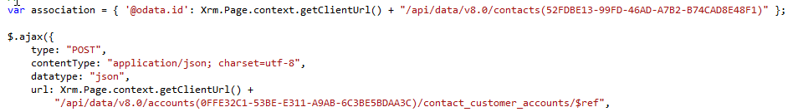
Associated Entities

Slide 32
Web Service Technologies

Slide 33
Existing Web Service Technologies
Raw Code
XMLHttpRequest
jQuery
Wrapper Libraries
XrmSvcToolkit
XrmServiceToolkit
Sdk.jQuery
SDK.REST
SDK.WebAPI

Slide 34
XMLHttpRequest
Raw code
You must prepare the request
You must parse the results (JSON)
Uses 2011 endpoint or WebAPI
May be synchronous or asynchronous

Slide 35
jQuery
Uses 2011 endpoint or WebAPI
Uses JSON data type
Automatically parses results from JSON into an object or array of objects

Slide 36
XrmSvcToolkit
SOAP Functions
FetchXML query
SetState
Execute
REST Functions
Create
Retrieve
RetrieveMultiple
Update
Delete
Associated
Disassociate

Slide 37
XrmServiceToolkit (SOAP Functions)
SOAP Functions
  Execute
  FetchXML query
  Retrieve
  RetreiveMultiple
  Create
  Update
  Delete
  QueryByAttribute
  QueryAll
  SetState
  Associate
  Disassociate
  Assign
  RetrievePrincipleAccess
  GrantAccess
  ModifyAccess
  RevokeAccess
  GetCurrentUserId
  GetCurrentUserBusinessUnitId
  IsCurrentUseRole
  RetrieveAllEntitiesMetadata
  RetrieveEntityMetadata
  RetrieveAttributeMetadata

Slide 38
XrmServiceToolkit (REST Functions)
REST Functions
Create
Retrieve
RetrieveMultiple
Update
Delete
Associated
Disassociate

Slide 39
XrmServiceToolkit (Other Functionality)
Other Functionality
EnableField
DisableField
ShowField
HideField
UpdateRequiredLevel
GetObjectTypeCode
CalculateDaysBetween
AddNotification
AddControlNotification
ShowError
GuidsAreEqual
DisableAllControlsInTab
DisableAllControlsInSection

Slide 40
Sdk.jQuery
Functions
Create
Retrieve
RetrieveMultiple
Update
Delete

Slide 41
SDK.REST
Functions
Create
Retrieve
RetrieveMultiple
Update
Delete
Associate
Disassociate

Slide 42
SDK.WebAPI
Functions
Create
Retrieve
RetrieveMultiple
Update
Delete

Slide 43
WebAPI vs 2011 Endpoint

Slide 44
2011 Endpoint
Supports REST and SOAP calls
SOAP Calls
Entity and attribute names use logical name
REST Calls
Entity and attribute names use schema name
Perform CRUD operations only
May perform any SDK operation
SOAP request must be captured and coded
Entity collections end in Set, i.e. AccountSet, ContactSet
2011 endpoint is no longer listed on Developer Resources page

Slide 45
WebAPI
Overview
Entity and attribute names use logical name
Entity collections end in ‘s’, i.e. accounts, contacts
Supports many (hundreds) of standard SDK operations
WebAPI is all REST (oData 4.0)

Slide 46
Migrating Your Code

Slide 47
Perform a Code Inventory
Identify
What web service technologies are in use
SOAP and REST calls
JavaScript web resources where these are located
Any HTML pages that also access CRM data

Slide 48
Standardize
Pick a technology standard
Select an available library or create your own

Slide 49
Timing
Technically, you don’t have to do anything at the moment
We do not have a firm date for deprecation
Build the migration into your upgrade strategy

Slide 50
Code Conversion
Entities
All entity collection names must be converted from “Set” to “s”
Attributes
Must be converted to lower-case
Some attributes have different names
primarycontactid is now _primarycontactid_value

Slide 51
SOAP and REST to WebAPI
Common Operations
CRUD and Associate/Disassociation will be the easiest to migrate since the tooling exists
SOAP Operations
Will need to be migrated by hand
You should see a huge reduction in code
REST Operations
Will have to be written
Tooling is available, so it is merely recreating existing code

Slide 52
WebAPI Documentation
Plentiful, but complex
No hard examples for each and every call
No samples in the SDK

Slide 53
Tools
XrmToolkit
  http://www.xrmtoolkit.com
CRM REST Builder
  https://crmrestbuilder.codeplex.com

Slide 54
Code Review

Slide 55
Non-JavaScript-Related Discussions

Slide 56
Non-CRM-Based Applications
Platforms
External web sites
Mobile applications
Authentication
oAuth only
Application must be registered in Active Directory (Azure or Local)

Slide 57
Questions?

Slide 58
Thank You

